Slide 1
aRMA The FOgO(Gun Website)
Submitted and created by
Mahmudur Rahman Limon(1607049)

Slide 2
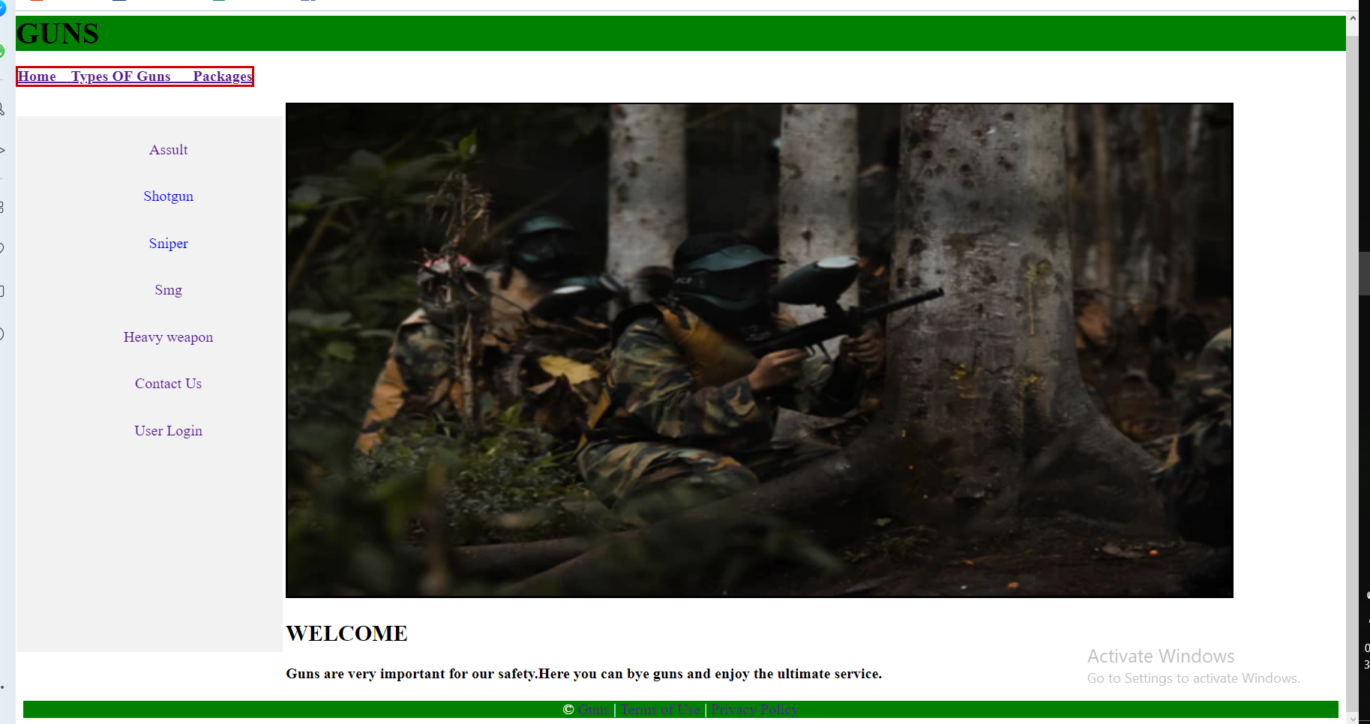
The first page (Homepage) of the website which created by asp.net.

Slide 3
Content of this website
1.asp.net
2.css
3.javascript
4.footer
5.session
6.cookies
7.login
8.DataBase

Slide 4
facilities
1.homepage
2.Loginpage
3.Gun Data add page
4.view different types of guns can be shown In packages
5.After buy inserted The cart
6.which product customer wanted to buy added to the shop page
7.The price ,payment and product can be seen in cart

Slide 5
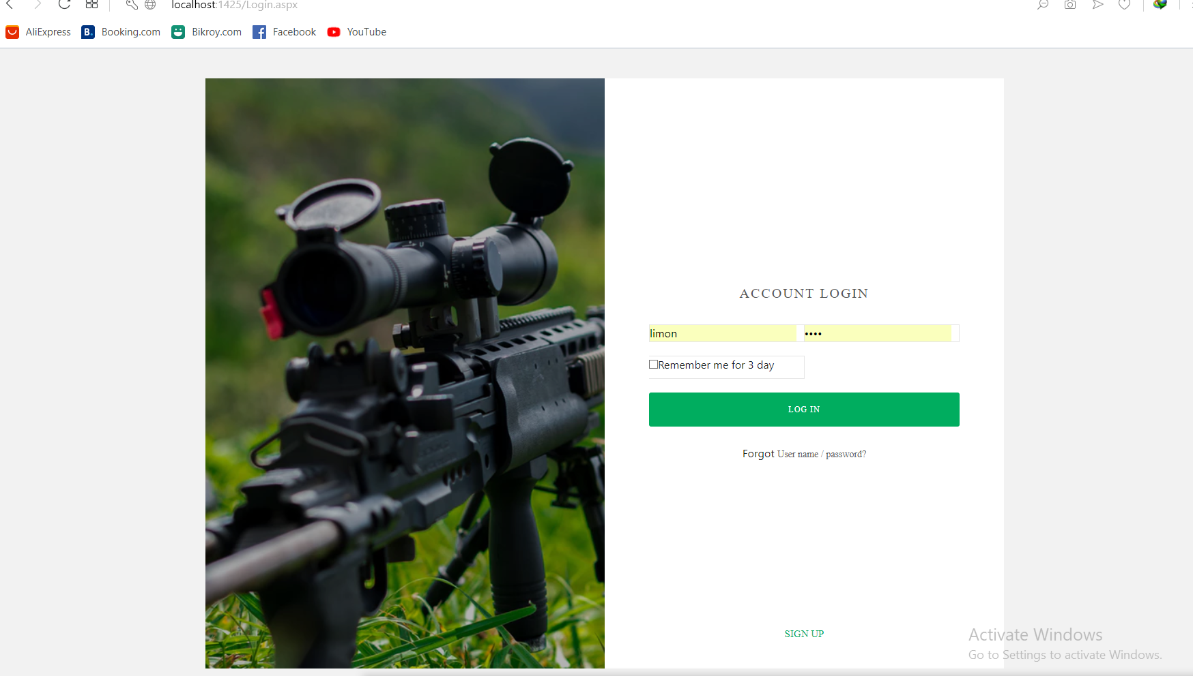
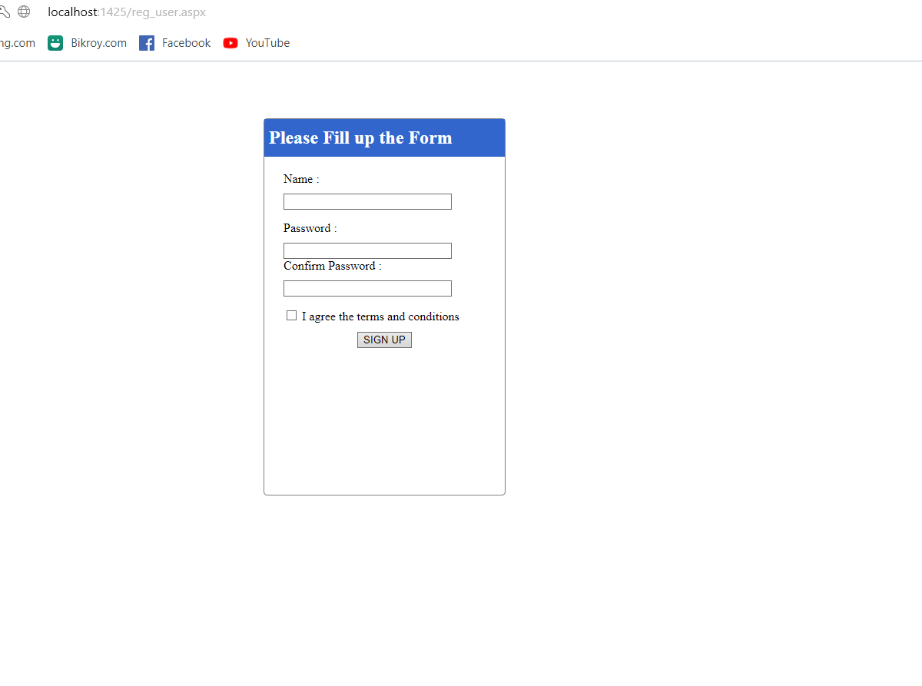
Login page
User login the website by this page

Slide 6
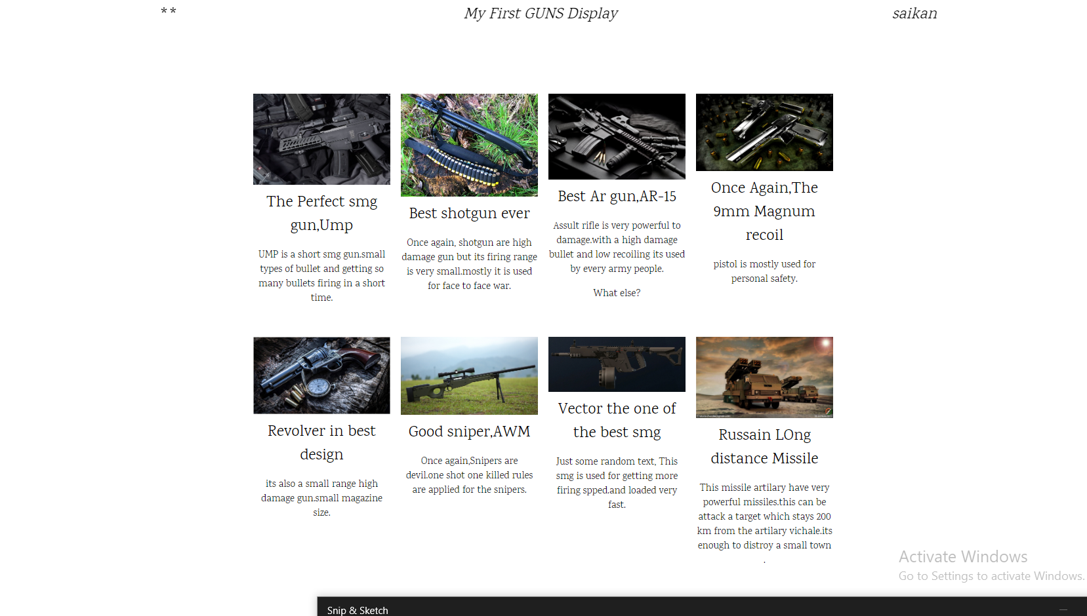
The packages page shows customer different types of gun qualituies

Slide 7
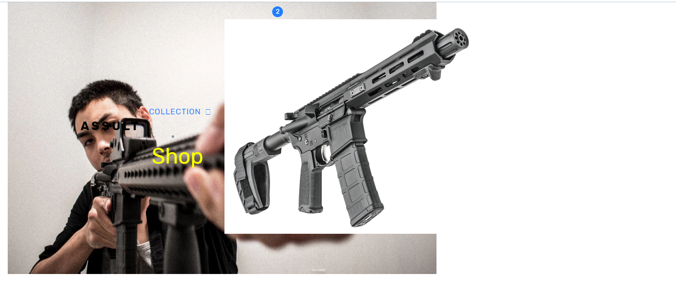
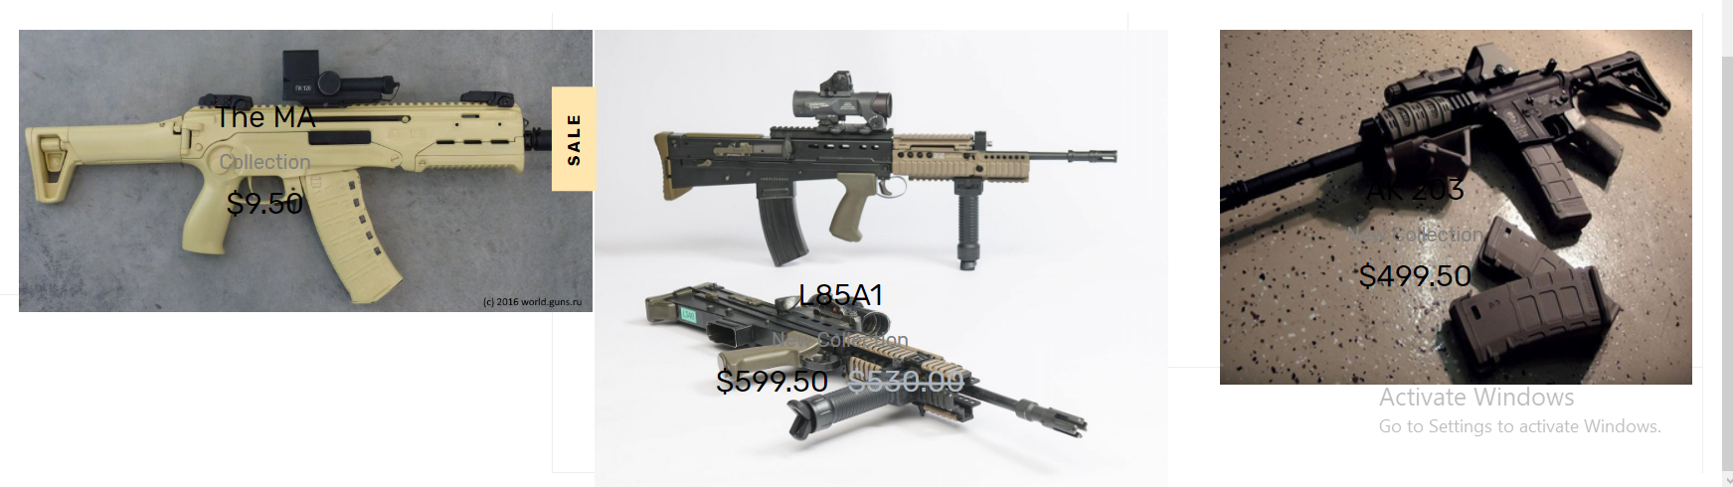
Assult page

Slide 8
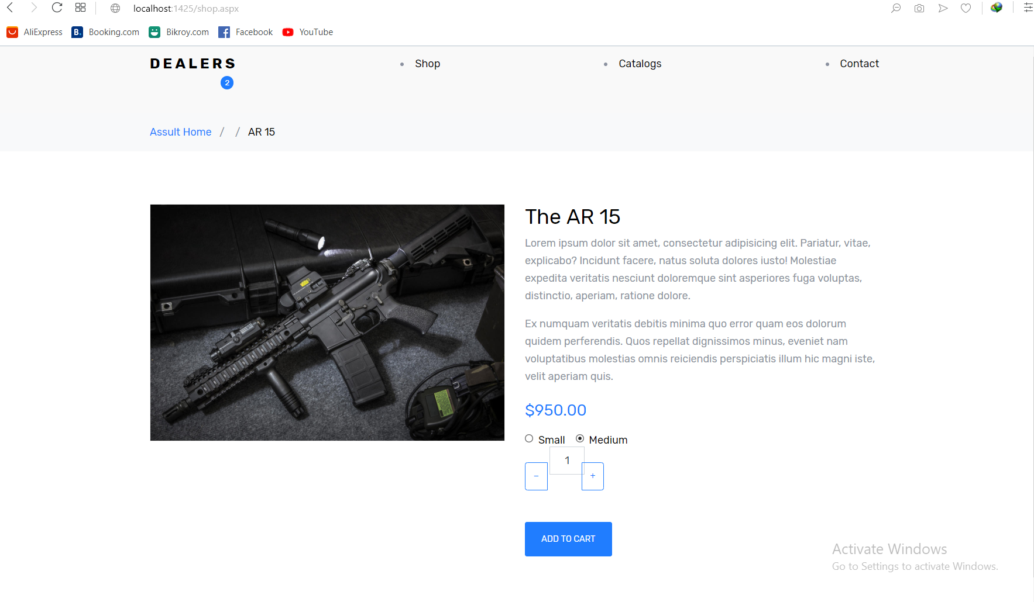
When customer press shop button then that time the product go to the shop page and the customer again check the product.

Slide 9
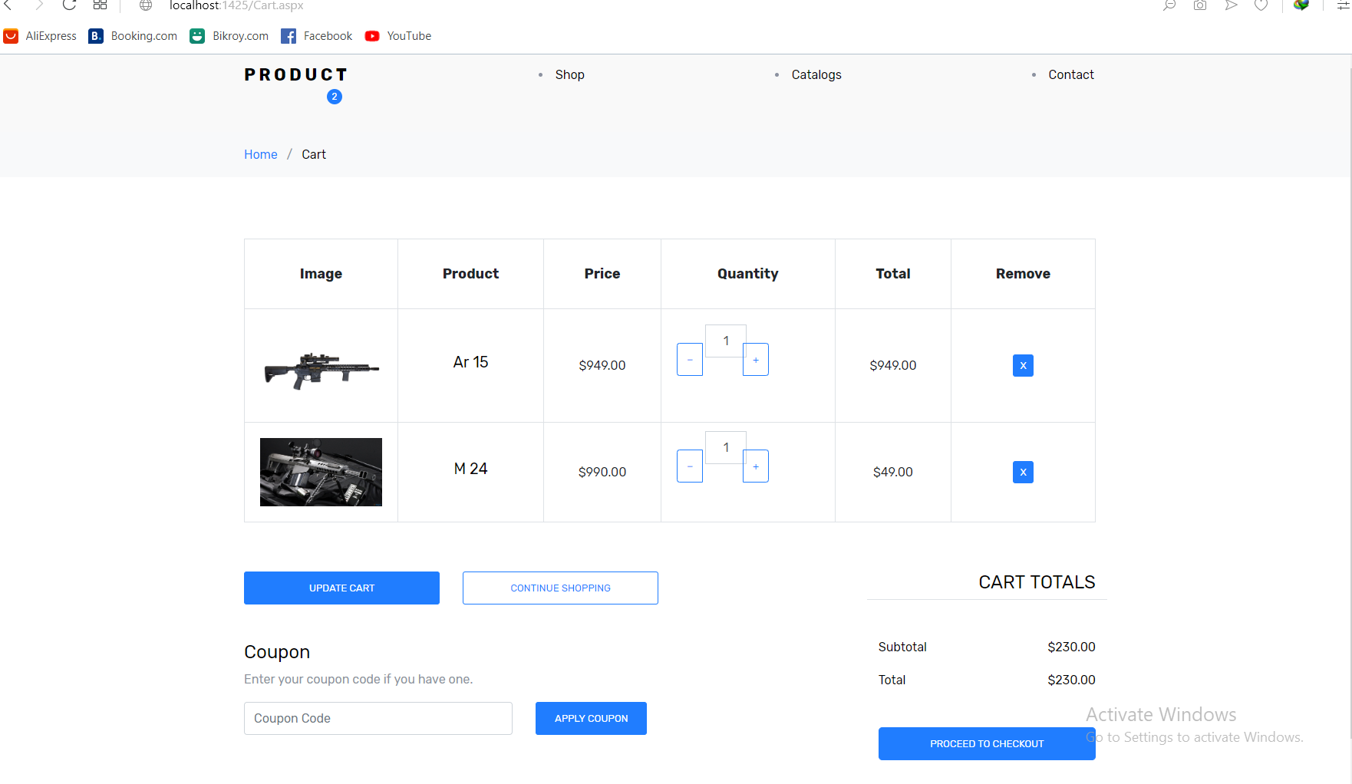
After next the product shift to the cart page and here customer should payment for the item.
Sometimes the item can be bought with coupon and credit card.

Slide 10
Thank you

